Slide 1
Federal Market – Key Technologies
Brian Haney
Sr. Vice President
April 22, 2010
Copyright © INPUT 2010

Slide 2
Agenda
FY 2011 IT Budget Request
Federal Outlook – Recap
Administration Priorities and Market Influencers
Key Technologies, FY 2010 – FY 2015
INPUT Key Technology Survey
Technology Market Perspectives
Conclusions and Recommendations

Slide 3
FY2011 Budget Request Overview
$2.3 trillion in mandatory spending
2% increase over FY2010
$1.1 trillion in regular discretionary budget authority
Three-year discretionary spending freeze
Excludes security spending – Defense, VA, DHS and the DOE’s National Nuclear Security Administration
Freezes discretionary spending at FY2011 level (2.8% higher than FY10 enacted budget) through FY2013
Expansion of some stimulus initiatives (e.g. health IT, Medicaid support, infrastructure)
Priorities include:
Healthcare/Health IT
Job creation
Education
Energy
Notes:
The FY2011 budget request includes a freeze in departmental discretionary budgets for the next three fiscal years – FY2011 through FY2013. However, this freeze would not apply to certain departments and programs that have a security-related mission, such as Defense, Veterans Administration, Homeland Security and Energy’s National Nuclear Security Administration.
Examples of stimulus program expansion:
Health Information Technology (IT) Adoption - $110M for continuing efforts to strengthen health IT policy, coordination, and research activities; $286 million in the Agency for Healthcare Research and Quality for research that compares the effectiveness of different medical options, building on the expansion of this research begun under ARRA.
S&L Medicaid support: The budget extends the Federal Medical Assistance Percentage (FMAP) relief through the end of June 2011 to help states deal with project budget shortfalls and contribute to job creation. This would provide an additional $25.5B.
Build America Bonds: States, localities and municipalities sell these bonds (debt securities) to finance capital investments. The Treasury Department pays issuers 35% of the interest paid to investors so that governments are offering interest rates that are competitive to corporations.
Support includes $266M for FY11 and $$1.2B for FY12. The Administration also proposes to expand the Build America Bond program beyond new investments in governmental capital projects.
Unemployment insurance benefits: $31M to extend the support started in ARRA.
Head Start/Early Head Start (nutritional/educational programs for schoolchildren): Extending the ARRA expansion of Head Start and Early Head Start, providing an increase of $1.6 billion.
Infrastructure:
S&L Highway Infrastructure Programs – outlays up from $59M to $267M in FY11
$3.3B to support clean water infrastructure
$530 million to help State and local governments invest smarter in transportation infrastructure and leverage that investment to advance sustainable development
$1B in funds to lay the foundation for a high-speed rail network (in addition to $8B provided in ARRA)
$7.2B for broadband expansion

Slide 4
FY2011 IT Budget Request
Total IT Budget Request: $79.4B
Overall Percent Change: -1.6%
+7%
-2%
-63%
+7%
-5%
+33%
+25.4%
Source: FY2011 OMB’s Report on Information Technology (Exhibit 53)
Notes:
Major Changes:
Defense - FY2011 is up nearly 7% over FY2010 enacted levels. Last year we saw a 3% decrease in the DOD IT budget vs. 2009. Biggest increases
$1.6B for NGEN in the Navy (which coincides with a $1.5B cut in NMCI)
$300m for EHR Way Ahead (the new health record system planned for DOD)
$300m for Installation Information Infrastructure Modernization, which consists of major IT and telecom upgrades for Army facilities
DHS – 2% decrease (first annual decrease since inception). Biggest decreases due to $100m from SBInet and $75m in Automated Commercial Environment
Transportation is dominated by Next Generation Air Transportation System (NextGen). The FY2011 budget of $557 million represents a 35% increase over the prior year.
Commerce – $3.1B decrease due to BTOP wind down and $700m due to Decennial Census wind down
NASA - 5% IT budget reduction planned for FY2011. Largest decrease from Space Operations ($75M) and $50m decrease in IT development related to Space Station
Education – 33% increase. Vast majority ($280m) associated with Aid Servicing which provides operations to collect Federal Student Loans from borrowers.
Labor – Decline in several programs within DOL’s Pension Benefit Guaranty Corporation (DOL corporate body), including its IT infrastructure (-$14.7M), Benefit Calculation and Valuation (-$10.7M), and Consolidated Financial Systems (-$8.0M) programs.
HUD - $100+M related to infrastructure modernization

Slide 5
FY11 Budget Request Trends and Priorities
Technology Priority
Policy Priority
Performance Priority
Acquisition Priority
3-yr Discretionary Spending Freeze
Mission Support Dashboards
Evaluation Initiative
Federal eMall
Stimulus/Job Creation
Energy
Data Center Consolidation
Improving Service Delivery w/IT
Stimulus and Job Creation
Federal Workforce
Information Security
High Priority Performance Goals
Health IT
Increased Oversight
Increased IT Oversight
Centralized IT Services Acquisition
Scientific R&D
Federal Performance Portal
Cloud Computing
Geospatial
Platform
Notes:
Technology Priorities include:
Cloud computing – aggressive push towards cloud government-wide deployment
Data Center Consolidation – is a central strategy to reduce costs and energy consumption, the administration will be pushing for the consolidation of the federal government’s 1100+ data centers
Health IT– push implementation of the HITECH Act of 2009 and the use of electronic health records
Information Security – emphasis on securing government systems through a real-time security posture
Geospatial Platform – create a geospatial platform to support GeoOneStop and other future programs.
Energy – reducing energy consumption, as well as developing and advancing clean energy technologies.
Scientific R&D – discovery and innovation for promoting economic growth and job creation.
Improving Service Delivery with IT – improving service to citizens through effective IT
Policy Priorities Include:
IT Oversight and Accountability – transparency and accountability models, such as Recovery.gov
Federal Acquisition/IT Workforce – overcoming deficiencies in acquisition and IT professionals
Stimulus/Job Creation – build on efforts of the Stimulus package for economic growth and job creation.
3-Yr Discretionary Budget Freeze – Starting in FY2011, equals approximately one-sixth of the total federal budget
Performance Priorities Include:
High Priority Performance Goals – boost productivity, cut costs, and deliver high levels of customer service.
Federal Performance Portal – redesign public access to federal performance information with a portal that provides a clear, concise picture of federal goals and measures
Mission Support Management Dashboards – The performance portal will also provide easy links to mission-support management dashboards.
Evaluation Initiative – To answer questions about the social, economic, or environmental impact of programs and practices
Acquisition Priorities Include:
Program reviews – reduced funding for poor performing programs
Acquisition/IT Workforce – increase the federal workforce across government, with DoD leading the list of departments
Increased oversight - OMB will be revising contracting guidance
Focus on insourcing – control contractual cost growth and “right-size” the workforce to pre-2001 levels.
Reduce reliance on cost-plus and time and materials contracts – a renewed focus on fixed-price contracts and reducing the percentage of contracts represented by cost-plus and T&M

Slide 6
FY11 Technology Priorities
The following select IT initiatives are high priorities for the respective departments, based on funding levels, % of total agency IT budget, or % of funding that is DME.
Defense
DHS
HHS
VA
• WIN-T - Ground Forces Tactical Network for integrated tactical communications supporting the Army’s LandWarNet strategy – $430M – TBD% DME
• Next Generation Enterprise Network (NGEN) will provide secure net-centric data and services to Navy & Marine personnel – $327M –TBD% DME
Secure Border Initiative (SBInet) to provide a mix of technologies to secure northern and southern borders – $435M – 72% DME
USCIS – Transformation to move from paper-based filing systems to a centralized, consolidated, electronic adjudication filing system. –$367M – 88% DME
NIH IT Infrastructure for network infrastructure, cyber security, office automation, help desk support, and telecommunications – $300M – 0% DME
CMS IT Infrastructure - Ongoing for Medicare and Medicaid information access support – $189M – 0% DME
Medical IT Support for information systems, computing, and network infrastructure that support the delivery of medical care. – $1.5B – 0% DME
Corporate IT Support for information systems supporting corporate management – financial, asset, human capital, cybersecurity, privacy, etc. – $231M – 0% DME
Notes:
Defense
WIN-T - Ground Forces Tactical Network is the cornerstone tactical communications system supporting the implementation of the LandWarNet strategy during the 2007 to 2025 timeframe. The WIN-T program is establishing a single integrating framework creating a network of networks for the Army.
Next Generation Enterprise Network (NGEN) - forms the foundation for the Navy’s future Naval Network Environment. NGEN is an enterprise network which will provide secure, net-centric data and services to Navy and Marine personnel and represents the continuous evolution of information technology at the Department of Navy (DON).
DHS
CBP - Secure Border Initiative (SBInet) – SBInet integrates the optimal mix of technologies into a comprehensive border security suite. This system improves CBP's ability to respond to illegal activity and helps DHS manage, control, and secure the border.
USCIS - Transformation The United States Citizenship and Immigration Service (USCIS) is carrying out an enterprise-wide transformation program to move out of a paper-based filing system into a centralized, consolidated, electronic adjudication filing system.
HHS
NIH IT Infrastructure - The NIH IT Infrastructure program consists of network infrastructure, cyber security, office automation, help desk support, and telecommunications for NIH-wide tools used by internal and external researchers, patients, and the public.
CMS IT Infrastructure – Ongoing - CMS IT Infrastructure implements IT that is essential in serving Medicare & Medicaid beneficiaries, provides partners and stakeholders with prompt, secure access to information for decision-making purposes, and supports other IT objectives.
VA
VA’s Medical IT Support includes all planning, development, modernization, enhancement, operations and maintenance, and disposal activities and resources for information systems, computing, and network infrastructure that support the delivery of medical care.
Corporate IT Support provides operations and maintenance of information systems and infrastructure that support corporate management, financial resource management, asset management, human capital management, cyber security, privacy, and other services.

Slide 7
FY11 Technology Priorities, Cont.
The following select IT initiatives are high priorities for the respective departments, based on funding levels, % of total agency IT budget, or % of funding that is DME.
DOT
Treasury
Justice
USDA
Next Generation Air Transportation System (NextGen) replaces FAA’s existing ground-based radar surveillance system with a satellite-based surveillance system – $557M – 86% DME
En Route Automation Modernization (ERAM) replaces FAA’s host computer HW & SW – $220M – 61% DME
IT Infrastructure Mainframes and Servers Services and Support (ITI MSSS) tracks cost savings and optimization efforts – $732M - 6% DME
IT Infrastructure Telecommunications Systems and Support (ITI TSS) - Tracks optimization and cost-savings efforts for data networks and telecommunications – $391M – 0% DME
JMD Law Enforcement Wireless Communication (LEWC) - replacement and modernization of radio systems – $2008M – 51% DME
FBI Next Generation Identification (NGI) -upgrade to the current IAFIS program providing new biometric functionality – $208M – 61% DME
Advanced Planning Documents (APDs) -- IT Investments Grants to States – $403M – 17% DME
Forest Service Computer Base provides IT infrastructure necessary for e-Gov – $282M – 0% DME
Farm Program Modernization (MIDAS) to improve business processes – $91M – 100% DME
Notes:
Transportation
Next Generation Air Transportation System (NextGen) - is designed to transform America's air transportation system to make way for an up to three-fold increase in air traffic while continuing to operate safely, securely, and efficiently.
En Route Automation Modernization (ERAM) - ERAM replaces the Host computer system software/hardware, Direct Access Radar Channel (backup) sw/hw, other associated interfaces, communications and support infrastructure; enables implementation of emerging performance-based National Airspace System (NAS) capabilities.
Treasury
IT Infrastructure Mainframes and Servers Services and Support (ITI MSSS) - Tracks optimization and cost-savings efforts including data center consolidation, server virtualization and green IT.
IT Infrastructure Telecommunications Systems and Support (ITI TSS) - Tracks optimization and cost-savings efforts for data networks and telecommunications. Also represents all Treasury operations and maintenance in these areas.
Justice
JMD Law Enforcement Wireless Communication (LEWC) - supports the replacement and modernization of failing radio systems, correction of security deficiencies, addresses mandated technical standards, and achieves communications standards that directly support Agent Safety for the DOJ s law enforcement agencies.
FBI Next Generation Identification (NGI) - The NGI Program is an upgrade to the current IAFIS providing new biometric functionality. The NGI Program will accommodate increased information processing and sharing for law enforcement agencies
USDA
Advanced Planning Documents (APDs) -- IT Investments Grants to States - APDs are the approval and funding process for state agencies to apply for and receive funding to implement ADP services supporting state administration of Food Stamp and Special Nutrition programs.
Forest Service Computer Base - Forest Service Computer Base provides IT Infrastructure (i.e., PCs, servers, & corporate SW). The initiative is vital to ensure FS can continue to carry out its natural resource mission in an e-Government environment.
Farm Program Modernization is part of Agriculture’s initiative to Modernize and Innovate the Delivery of Agricultural Systems (MIDAS). It provides for the modernization and innovation of Farm Programs through improved business processes & state of the art IT technology.

Slide 8
FY11 Technology Priorities, Cont.
The following select IT initiatives are high priorities for the respective departments, based on funding levels, % of total agency IT budget, or % of funding that is DME.
Commerce
Energy
NASA
Others
Commerce Consolidated IT Infrastructure (CCII) to optimize and manage dept-wide IT infrastructure management framework – $536M – 5% DME
NOAA Geostationary Operational Environmental Satellite (GOES-R) Series Ground Segment monitors and controls NOAA's GOES-R satellites – $381M – 100% DME
Consolidated Infrastructure, Office Automation, and Telecommunications Program – $926M – 5% DME
ORNL Leadership Computing Facility Management System – $96M – 10% DME
ANL Leadership Computing Facility Management System – $62M – 20% DME
NASA IT Infrastructure consolidates data center services agency-wide – $587M – 12% DME
KSC Constellation Ground Operations Command & Control for the Constellation Program – $68M – 100% DME
NASA Financial / Business Management Program provides operations and support for business/financial modules – $64M – 13% DME
• Education: Aid Servicing – $498M – 0% DME
HUD: Transformation Initiatives – $226M – 100% DME
Interior: Financial & Business Mgt Sys (FBMS) – $92M – 60% DME
Labor: Infrastructure Optimization – $114M – 3% DME
SSA: Infrastructure -Data Center – $375M – 5% DME
Notes:
Commerce
Department of Commerce Consolidated IT Infrastructure (CCII) - is to effectively optimize & manage its federated IT infrastructure management framework. Using transparency, it encompasses Desktop/IT Helpdesk, Telecommunications, Servers and IT Data Centers.
NOAA/GOES-R Series Ground Segment - monitors and controls NOAA's GOES-R satellites, the next generation of geostationary environmental satellites.
Energy
Consolidated Infrastructure, Office Automation, and Telecommunications (IOA&T) Program - This program supports DOE's business and mission processes in the areas of telecommunications and networks; application and data hosting/housing; office automation; telephony; enterprise collaboration service; and cybersecurity.
Oak Ridge National Laboratory Leadership Computing Facility Management System ensures compliance and review of legal directives and guidance to staff.
Argonne National Laboratory Leadership Computing Facility Management System ensures compliance and review of legal directives and guidance to staff.
NASA
NASA IT Infrastructure -The NASA IT Infrastructure investment operates and maintains computer facilities, hardware, software, and telecommunications capabilities deployed in support of the various NASA missions and agency workforce.
Kennedy Space Center Constellation Ground Operations Command & Control - Investment covers development of KSC Command Control and Communications systems for the Constellation Program.
NASA Financial / Business Management Program - NASA Enterprise Applications Competency Center provides operations and sustaining support (business process/application functionality/application development/application operations/infrastructure support) for a variety of business/financial modules.
Others
Education: Aid Servicing - Aid Servicing provides operations to collect Federal Student Loans from borrowers.
HUD: Transformation Initiatives - The Transformation Initiative is aimed at enabling greater capacity and flexibility in responding to critical short and long term departmental needs.
Interior: Financial and Business Management System (FBMS) - integrating administrative processes throughout the Department of the Interior.
Labor: DOL Infrastructure Optimization - encompassing telecommunications systems and services, end user systems and services, and data center services and support.
SSA: Infrastructure -Data Center - maintaining, enhancing and protecting the IT environment that administers SSA's payment systems.

Slide 9
Obama Policy Priorities and Impact on Technology
Modernize the nation’s electric grid
Utilize electronic health records to reduce costs
Expansion of cyber operations
Expand broadband to underserved and rural areas
Reduce energy consumption
Expand health care to uninsured
Consolidation of networks to improve cybersecurity
Energy/ Conservation
Healthcare
Broadband
Cybersecurity
Notes:
The stimulus package offered insight into the Obama administration’s long-term priorities.
Energy
President Obama vows to double investments in basic research during the next decade, in part by establishing organizations to field innovative, breakthrough technologies. Efforts will primarily focus on renewable energy (solar, wind, geothermal); fuels from sunlight; batteries and energy storage; grid materials, devices and systems; capture and sequestration technologies; energy-efficient building systems design; extreme materials; and modeling and simulation.
Healthcare
the climbing costs of healthcare are driving plans to invest in healthcare reform and health IT solutions that will support reform.
DOD health costs were $18B in 2001 and now exceed $40B
VA health costs up from $20B to $40B
Broadband
the plan is to extend broadband to rural and underserved areas. Broadband expansion has a number of related implications, such as facilitating telework, supporting the energy grid and providing the foundation for health information exchange.
$7B in
Cybersecurity
Movement to centralize cyberseciryt in federal government – argument is over where and who
Technology evolving to support more centralization of monitoring, real time monitoring

Slide 10
Federal Technology Priorities
Cloud pilots conducted in 2010
Agencies to “consider” cloud for all future IT needs
Agency inventories due by April 30th
Cloud Computing
Consolidate 1100+ data centers
Reduce energy consumption
Reduce the costs of hardware, software, and operations
Data Center Consolidation
Health IT
HHS standards development
Continued promotion of EHRs
Long-term implications for reform
Notes:
The main priorities are cloud computing, health IT and data center consolidation.
Cloud computing: The FY2011 budget request clearly identifies a continued and aggressive push towards cloud computing. This year, the feds will be conducting and evaluating pilot programs, with broader deployments in FY11, FY12 and beyond. Vivek Kundra, the Federal CIO, recently announced a plan for centralized certification to streamline the process for cloud computing providers. Although not officially mandated, agencies are being urged to consider cloud solutions for any new IT needs moving forward.
Data Center Consolidation- This is a central factor in this administration’s technology strategy. To reduce costs and energy consumption, the administration will be pushing for the consolidation of the federal government’s 1100+ data centers (up from 432 in 1998). OMB will lead the effort by developing the government-wide strategy for reducing the number, costs and energy consumption of federal data centers and there’s an aggressive timeline for agencies to conduct inventory and develop consolidation plans. Virtualization, storage and open source are some of tools discussed in this effort. Generally data center consolidation comes with upgrades in software and equipment to the retained, but enlarged data centers which are good opportunities for the IT infrastructure providers. Large integrators tend to be the operators of the larger data centers. Smaller data centers will be consolidated and those are more likely to be supported by smaller firms.
Health IT and IT for Healthcare– Healthcare reform was recently passed and has tremendous implications for health IT. We see continued work in pushing the use of electronic health records and developing standards. The goal of healthcare reform is to improve health outcomes and use those outcomes to compensate providers, and health IT systems will help provide the data and analytics to help the government figure out how to do that.

Slide 11
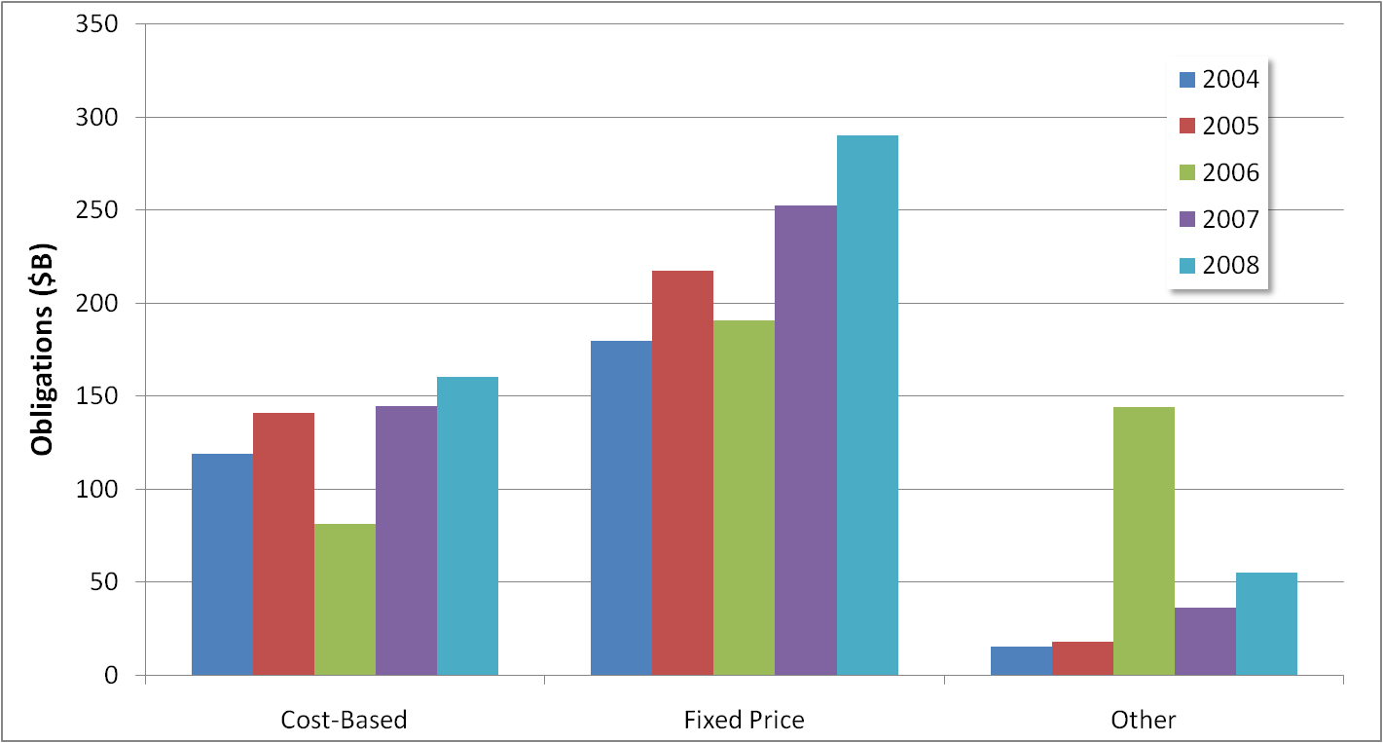
Goal to Limit Cost-Plus and Other “High-Risk” Contracts
FY08 Top Users of
Cost-Plus Contracts
DOD – 65%
Energy –15%
NASA – 9%
HHS – 4%
DHS – 2%
Other – 5%
*Total contracts, not just IT.
Source: FPDS, INPUT
Notes:
One major thrust of Obama’s acquisition reform is to limit dollars awarded through cost-plus, time & materials, and other types of contracts deemed “high-risk” by Obama and to shift more spending to fixed-price contracts.
However, INPUT’s analysis of total obligations from FY04 through FY08 show that while the dollar value of total obligations through cost-plus type contracts has indeed grown, obligations through fixed-price contracts has increased much more significantly most of the years since FY04.
DOD is by far the largest user of cost-plus contracts with 65% of their total contracted obligations being cost-plus type contracts.

Slide 12
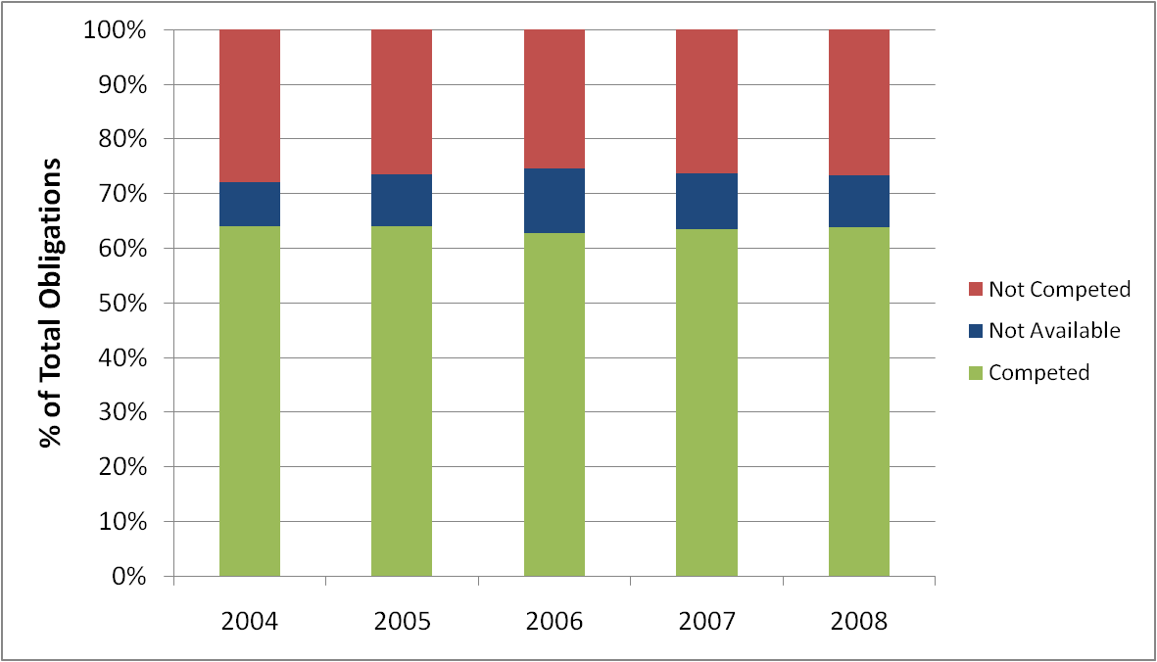
Goal to Compete More Contracts
Consistently almost 65% of the value of total obligations has been competed each year since 2004.
Source: FPDS, INPUT
Notes:
Though Obama says that he wants more contracts compete, in all of the last 4 years (FY04 to FY08) less than 30% of all dollars obligated were not subject to a competitive process and almost 65% of all dollars obligated were competed. These figures have been consistent over the last four years, so, despite perception, this is not a new or recent problem that has emerged.

Slide 13
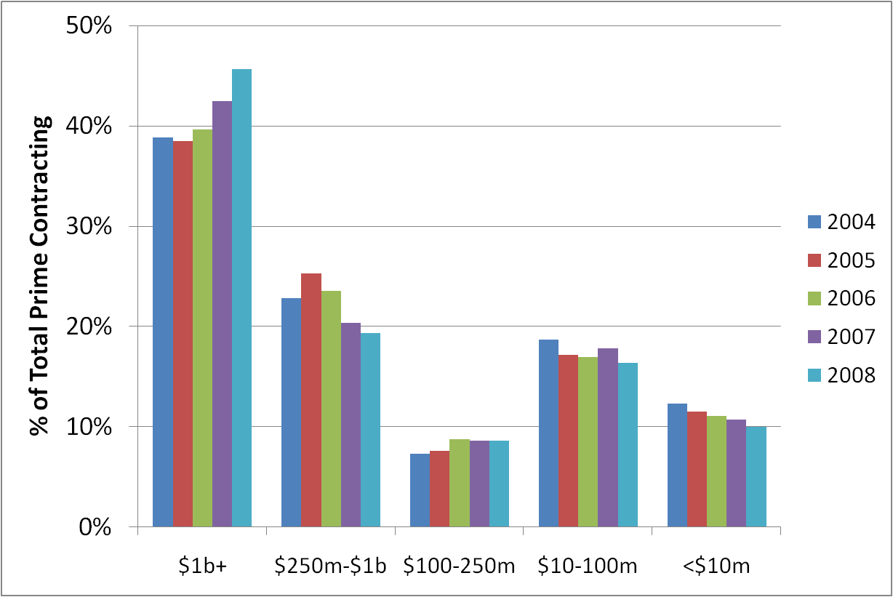
Small & Mid-Sized Firms Have Been Squeezed
With contract consolidation, contractors with over $1 billion in revenue have increasingly gained a larger share of the federal prime market at the expense of small and medium-sized contractors.
Source: FPDS, INPUT
Notes:
The market has also witnessed steady increase in the value of contract awards to companies with $1 billion in revenue or greater and a squeeze on small and mid-tier contractors who have lost share on a total contracted value basis.
Over 70% of dollars are controlled by companies with greater than $100 million in revenue.
There are also more companies entering the federal market:
Number of companies from FY03 to FY07
$1B + 6 11
$250-$1B 18 28
$100-$250 26 44
$10-$100 343 463
<$10M 11,500 21,000
A recent paper by Aaron A. Cheifetz of the Naval Postgraduate School in Monterey, California, entitled “The Effect of Acquisition Reform on Small Business Participation in the Federal Marketplace” found that acquisition reform has had a negative effect on small business participation in federal contracting.
“As a result of the transformation of the Federal acquisition process through acquisition reform legislation and the reduction in the acquisition workforce, small business contractors are faced with new challenges to compete for and win Federal contracts. The paper concentrates on examining contract bundling, reverse auctions, electronic commerce and multiple award schedules. It concludes that contract bundling has had a negative effect on small businesses by excluding them from many competitions. Regarding multiple award schedules, the research supports benefits for small businesses when they are given the chance to compete through multiple award schedules. It also finds negative implications for small businesses in that multiple award schedules often favor large established businesses at the expense of small businesses.” Source: http://www.stormingmedia.us/49/4922/A492224.html

Slide 14
Agencies Creating “One Stop Shops”
Agencies have been consolidating multiple contracts into agency-specific single task order contracts
Leveraging buying power
Simplifying contract administration
Avoiding GSA fees
Examples: NASA I3P, HHS, DIA SITE, Army ITES, Air Force NetCents or NAVY Seaport-e, DHS EAGLE
May draw administration attention due to potential impact to competition.
Additionally, GSA announced there will be no more GWAC contracts created and will be relying on ALLIANT. Letting three expire (Millennia, Millennia Lite, and Answer).
Impact for vendors: Fewer GWAC contracts to bid on; greater competition for those that continue.
Notes:
For several years now, there has been a trend in the federal government to consolidate contracts. Consolidation is expected to continue due to the cost, management implications, and pressure from the Obama administration for better financial and program management.
Recently, Washington Technology reported that GSA has announced they are not going to issue any more GWACs, as indicated by a comment by Ed O’Hare, the General Services Administration’s assistant commissioner of the Office of Integrated Technology Services at the Federal Acquisition Service. O’Hare also reportedly said that Alliant and Alliant Small Business will be GSA’s primary GWAC going forward as GSA is letting Millennia, Millennia Lite, and Answer expire. Additionally, GSA also convinced the Commerce and Transportation departments to give up their GWAC contracts, and brought Commits and Information Technology Omnibus Procurement II (which as has since expired) under GSA.
Sources: http://washingtontechnology.com/articles/2009/06/24/gsa-to-end-gwac-programs.aspx
http://washingtontechnology.com/blogs/editors-notebook/2009/06/gsa-gwac-era-ends.aspx
Agencies are looking to use their buying power to get lower prices for products and services by consolidating multiple contracts into one. As a result, the risks for government contractors bidding on follow-on work is nearly as high as it was for bidding on the original contract. However for many contractors, the new consolidation contracts are affording new opportunities.
Contract consolidation, like contract bundling in the 1990s, may get some attention from the new administration for a number of reasons:
It may limit competition by placing many projects out of the reach of the capabilities of small companies. However, agencies are often providing set-aside opportunities to address this, but there may be further analysis done to determine if current actions are enough.
It may reduce or eliminate bidder interest and the level of competition for the procurement due to the costs of competing compared to the likelihood of winning task orders.
Both of these factors may limit competition, which impacts the federal government’s pricing benefits.

Slide 15
Transparency & Open Government Directive
Implications for Vendors
Web 2.0 opportunities
Sub-recipient reporting
Greater scrutiny & risk
Prizes!!!
Goals
Transparency
Participation
Collaboration
Goals
Requirements
Implications
Requirements of Govt
New data sets
Establish open gov Web site
Designate leader
Create a plan
Accountability on data quality
Replacement of PART

Slide 16
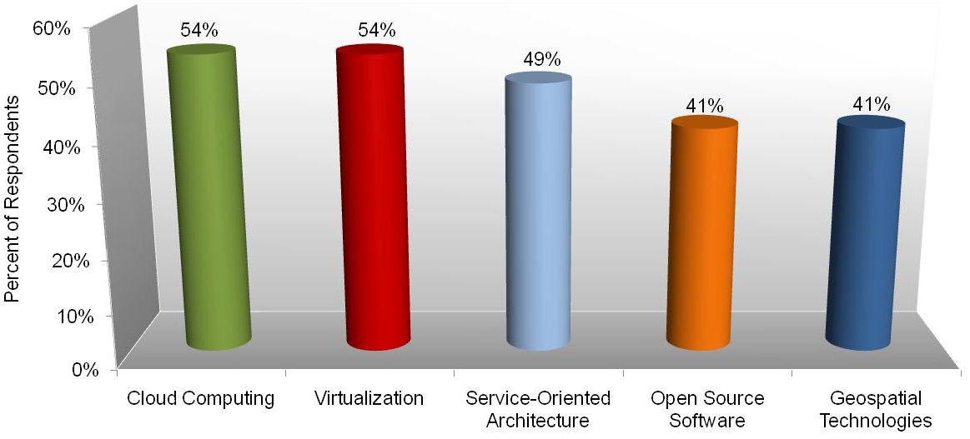
INPUT Survey: Agencies Perceive These Technology Solutions As High Impact
Percentage of federal respondents rating the impact of these technologies as a “4” or a “5,” where 1=No Impact and 5=Major Impact.
n=37
INPUT’s Take: Agencies anticipate these technologies having a major impact on their technology environment in the next 5 years in data center consolidation, migration to plug-and-play environments, geographical distribution of computing power, and information sharing.
Source: INPUT survey
II. Executive Summary
Notes:
Over half of the federal IT organizations surveyed felt that cloud computing and virtualization would have a major or significant impact on their organization.
Many organizations recognize the potential benefits of cloud computing and plan to test or pilot a cloud computing project in the near future. Adoption will become more widespread among federal agencies overtime as benefits become realized.
Many agencies have already achieved significant savings by implementing virtualization. Agencies stating that they believed virtualization would have a major impact on their organization in the next year, have plans for further virtualization projects. Server virtualization is the most widespread application to date.
48.6% of respondents also believed that Service Oriented Architecture would greatly impact their organization in the next year by allowing them to be more agile with application development, to improve sharing of information, and to better control their information assets.

Slide 17
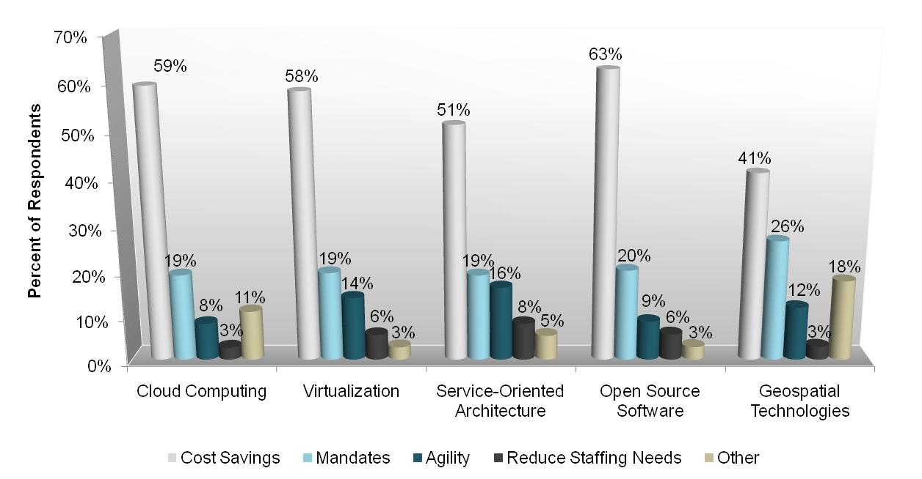
INPUT Survey: Primary Drivers to Adoption
n=37
Margin of Error = +/-8%
Source: INPUT survey
II. Executive Summary
Notes:
Cloud Computing
Potential cost savings was cited as the primary driver for the adoption of cloud computing by 59.5% of agency respondents. With continued minimal increases in federal IT budgets, the allure of a technology concept that can potentially substantially lower costs is extremely attractive to IT organizations. Pressure from the administration will also fuel adoption efforts. Reducing staffing needs or agility ranked low as drivers for cloud computing among respondents.
Virtualization
There is confidence that the government is both willing and able to increase adoption of virtualization. If industry can effectively address the security barrier, agencies will begin to increase investments in virtualization.
SOA
Saving money is critical for agencies in the current fiscal environment, so the impact on budgets is top-of-mind.
Industry respondents focused more on agility, which is a benefit of SOA but not the primary selling point at this stage of adoption. If vendors can tie agility to an agency’s specific environment and illustrate how SOA can directly impact their specific environment, they will see more interest.
OSS
Cost savings comes in the form of lower licensing fees and the ability to re-use and modify code. Because of the lower upfront costs of OSS, agencies are able to use O&M budgets to fund OSS acquisitions rather than capital budgets.
Geospatial Technology
41% of respondents cited cost savings as the primary driver for future investment or enhancement to geospatial systems in their organization. Even though upfront investment in geospatial systems can be costly, agencies realize that they can gain cost savings on the back-end by being able to make better business and mission decisions due to the ability to view information and data in a spatial format.
However, industry respondents believe that agility would be the primary driver for future federal spending on geospatial systems. Vendors should not only promote agility when marketing geospatial systems to the government, but they should also capitalize on the perceived cost savings that can be achieved by implementing or upgrading a system.

Slide 18
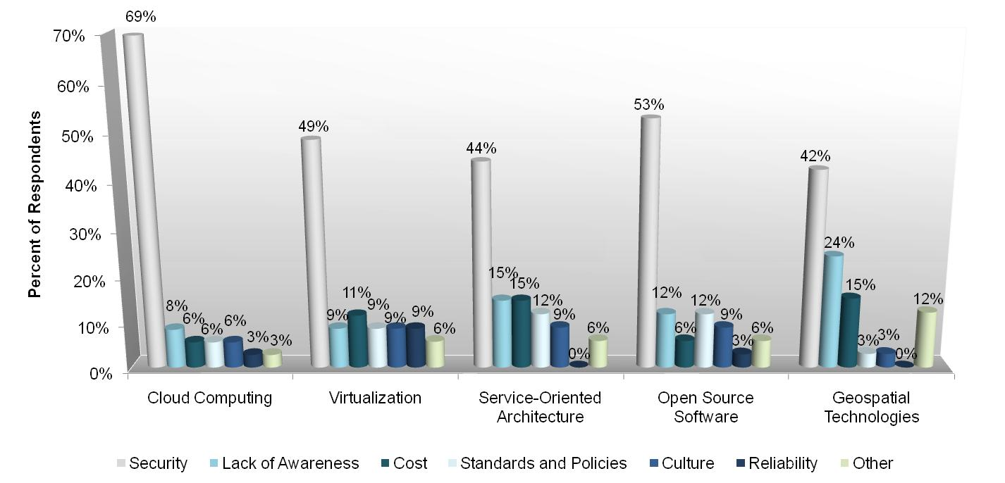
INPUT Survey: Primary Obstacles to Adoption
n=37
Margin of Error = +/-8%
Source: INPUT survey
II. Executive Summary
Notes:
Cloud Computing
According to 69.4% of respondents, security is by far the biggest obstacle for cloud computing adoption. Agencies are concerned about the security of their infrastructure, data, and applications. Over time, the security and privacy issues surrounding cloud will be resolved. In the meantime, they will continue to be an obstacle for global adoption of cloud computing in the federal government.
Virtualization
Security concerns are a major impediment for government IT decision-makers. Stricter security guidance is pending, so there is sensitivity to any issues that may introduce additional vulnerabilities. Vendors must address this concern head-on to gain the attention of decision-makers.
For IT managers that have adopted virtualization on a small scale, cost is an obstacle to larger scale adoption because of the high front-end funding that needs to occur in order to capture the biggest (though long-term) benefits.
Industry respondents have faced issues with organizational culture as federal employees resist changes to current systems and processes.
SOA
Federal agencies are daunted by the idea of securing a SOA-based environment. The information sharing capability of SOA essentially opens gateways that can present security challenges.
While SOA deployed for infrastructure could present security challenges, it’s also possible to establish SOA as an enabler of security by making security easier to deploy and isolating re-usable components.
OSS
Over half of the federal respondents listed security concerns as the primary obstacle for further OSS adoption in their organization. Federal IT organizations are concerned about code purity and access to OSS code.
However, industry respondents believed reliability to be the biggest obstacle for federal adoption of OSS.
Geospatial Technology
Nearly half of the federal respondents believed that security was the biggest obstacle for implementing geospatial systems, as opposed to industry’s perception of awareness and standards as being the biggest obstacles to further adoption.
The federal opinion that lack of standards is a barrier to implementation, as was evidenced in the last administration’s Geospatial Line of Business, has changed. Only 3% of the respondents cited lack of standards and policies as a barrier to implementation.
Vendors should look to address agencies’ security concerns when marketing GIS solutions to potential federal customers.

Slide 19
Market Segment Forecast
Source: INPUT
Notes:
IT Services (Prof Svcs, SI, and Outsourcing) segments continue to be the strongest market segments, followed by Software. Drivers for IT services include Data Center consolidation and optimization, cloud computing, SOA, and healthcare reform, in addition to the ongoing human capital challenges the fed faces to meet the ever-increasing scope of government and the redefinition of areas that are considered “inherently governmental.”
Software is buoyed by data center consolidation and virtualization efforts as well as some cloud and SaaS.
Comm & Network Services will see some softening as cost savings and economies are achieved through Networx. The need for wireless, workforce mobility and telework/COOP provides a foundation for the current growth rates.
Computer Equipment segment continues to show the lowest growth opportunities due to consolidation and virtualization efforts and continued price competition.

Slide 20
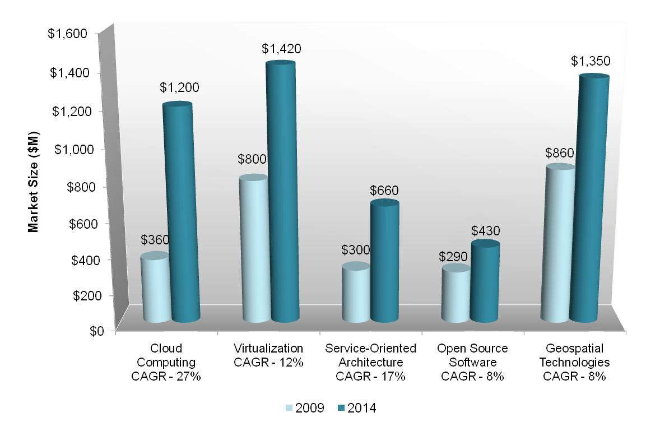
Emerging Technology Markets Forecast, FY2009-2014
Source: INPUT
II. Executive Summary
Notes:
Cloud Computing
The total federal cloud computing market is expected to grow from $370m in 2009 to $1.2b in 2014 at a compound annual growth rate of 27%. The largest growth will be in IaaS (CAGR 30%) and Applications (SaaS) (28%).
Virtualization
The virtualization market is poised to grow from approximately $800M in FY09 to $1.4B in FY14. Server virtualization represents the largest segment.
The total market Compound annual Growth Rate (CAGR) is significant, especially compared to the total market CAGR of 3.5%.
Storage virtualization will see a slight increase as well, as transparency requirements increase the volume of data the needs to be stored, managed and accessed.
SOA
The push for information sharing, transparency, and cloud computing will drive growth in the SOA market.
While the dollar amounts may only reflect a fraction of total IT spending, the growth rate is nearly 5 times that of the total market.
This growth will largely depend on the administration’s progress with cloud computing and other infrastructure and process initiatives.
OSS
The federal OSS market is projected to grow from $290m in 2009 to $430m in 2014 at an 8% compound annual growth rate. The largest growth is expected between 2009 and 2010 of $70m. This small growth spike is due to anticipated pressure from the current administration for agencies to evaluate and implement OSS-based solutions as an alternative to traditional software solutions.
Geospatial Technology
The federal geospatial technology market is projected to grow from $860m in 2009 to $1.4in 2014 at an 8% compound annual growth rate. Growth will be driven by the need to share geospatial information and data across federal organizations, as well as the need to provide information with geospatial metadata to constituents and the public.

Slide 21
Green Technology Motivators
Climate Change
Policy decisions rest on the conclusion that man-made greenhouse gas (GHG) emissions contribute to global warming.
Energy Security
Burning oil for electricity generation ranked 3rd behind coal and natural gas. The U.S. imports 12.9 million barrels per day of crude oil and refined petroleum.
Energy Costs
U.S. electricity consumption is forecast to grow 30% by 2030 and electricity prices to increase 50% by 2017. The federal government is the nation’s largest consumer of energy. At current levels, $6 billion annually by 2017.
Budget Crisis
The federal government budget deficit in FY 2010 is $1.42 trillion and growing.
Stimulus Funding to use by this year
High Growth Market: Larger, national economic and environmental factors are driving federal green IT policy. These challenges cannot be solved easily and will continue to drive green IT for years to come.
Notes:
Government goals: Lower GHG emissions by setting standards, reduce U.S. dependency on foreign oil through renewable energy programs, and save money by moving agencies to adopt energy efficient technologies.
Climate Change:
Despite controversy over the extent to which global warming is a result of man-made greenhouse gases released into the atmosphere, successive congresses and presidential administrations have based energy policy decisions on the argument that greenhouse gases are a significant contributing factor, which will have a major impact on rising sea-levels and weather intensity. The White House announced on November 25, 2009 that President Obama offered a U.S. target for reducing greenhouse gas (GHG) emissions to 17% below 2005 levels by 2020. The President has also stated that his goal is for an 83% reduction in GHG emissions by 2050.
Greenhouse Gas Emissions Reduction:
According to the U.S. Green Building Council, buildings consume approximately 72% of all electricity produced in the U.S. and produce 40% of all greenhouse gas emissions. In Executive Order 13514, announced in October 2009, President Obama made reducing the GHG emissions of federal buildings a central goal of his administration. This policy raises pressure placed on federal agencies by Congress and the Bush Administration to reduce emissions and implement sustainable energy policies. For example, under the 2005 Energy Policy Act, agencies must cut energy consumption by 30 percent by 2015 compared with 2003 levels. Agencies overall used 12.3 percent less energy in 2008 than they did in 2003, although half of the 22 agencies tracked by the Energy Department reported higher consumption in 2008 than in 2007.

Slide 22
Federal Data Center Challenges
Massive proliferation of federal data centers
Data centers can be 40x to 100x more energy intensive than office buildings
Federal data centers consume about 2.0% of all electricity generated in the US
The annual cost of electricity to operate federal data centers is approaching $1 billion
High electricity consumption equals high greenhouse gas emissions
Agency energy costs to operate data centers are exploding. Greening data centers through the use of innovative architectural and technological solutions is the most effective method of reducing costs and meeting the green goals mandated by Legislation and Executive Orders.
Notes:
Data Center Challenges
Data Center Energy Intensity:
In an EPA report to Congress in August 2007, the EPA estimated that “In 2006, federal servers and data centers alone accounted for approximately 6 billion kWh of US electricity use (10 %), for a total electricity cost of about $450 million annually.”
“Under current efficiency trends, national energy consumption by servers and data centers could nearly double again in another five years (i.e., by 2011) to more than 100 billion kWh, representing a $7.4 billion annual electricity cost.”
EPA's 2007 study estimated “The peak load on the power grid from [federal] data centers is currently estimated to be approximately 7 gigawatts (GW), equivalent to the output of about 15 base load power plants. If current trends continue, this demand would rise to 12 GW by 2011, which would require an additional 10 power plants.”
Greenhouse Gas Emissions:
The EPA study also concluded that greening data centers through consolidating servers, buying energy-efficient equipment, and utilizing alternative energy sources could cut … greenhouse gas emissions by as much as 47 million metric tons a year

Slide 23
Data Center Consolidation – 1995 vs. 2010
Component | 1995 | 2010
Rational/Goals | Reduce costs | Reduce energy use Reduce costs Improve security Improve efficiency
Time to Provide Inventory | 6 months | 2 months
Plan | 8 months | Initial: 4 months Final: 6 months
Definition of Data Center | FTEs >5 | Room devoted to data processing (sq footage)
Target Criteria | Processing Capacity | Not indicated
Notes:
1. Purpose. This Bulletin provides guidelines for significantly reducing the number of agency data centers and reducing the total cost of data center operations governmentwide. This Bulletin calls for agencies to:
Reduce the total number of agency data centers during the next 24 months, by closing many currently operating data centers and concentrating their operations into a smaller number of physical locations.
Collocate small and mid-tier computing platforms in larger data centers.
Modernize remaining data centers in order to improve the delivery of services.
Outsource information processing requirements to other Federal or commercial data centers if the aggregate installed base is below minimum target sizes

Slide 24
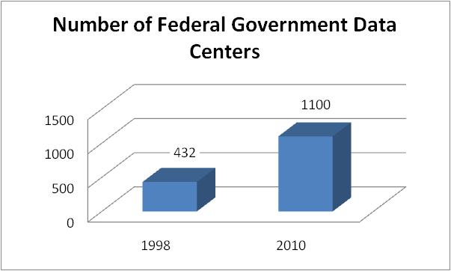
Data Center Consolidation
Goals:
Promote the use of Green IT by reducing the overall energy and real estate footprint of government data centers
Reduce the cost of data center hardware, software, and operations
Increase overall IT security posture of the government
Shift IT investments to more efficient computing platforms and technologies
Timeline:
Agency inventories due by April 30th
Preliminary consolidation plans due by June 30th
Final asset inventories due by July 30th
Final plans to be approved by OMB by December 31st
Implementation to begin in 2011
Source: FY2011 Budget Request
Notes:
The federal government has embarked on what promises to be the largest data center consolidation in history.
On February 26, 2010, Vivek Kundra, Federal CIO, outlined his ambitious plans in a memo to federal agencies. Federal data center consolidation plans will greatly impact system integrators, data center service providers, and cloud computing platforms. It will also generate business for vendors that provide energy efficiency tools and consulting. According to Kundra, “the federal government is looking for game-changing approaches, rather than brute force consolidation.”
Kundra has designated Richard Spires, CIO for DHS, and Michael Duffy, CIO of the Treasury Dept., to lead this effort within the Federal CIO Council. Consolidation efforts are likely to boost data center demand, especially where the cloud model doesn’t make sense. Many of the current data centers may be rendered obsolete due to power capacity needs, leading to the need for new data center space. Consolidation is also likely to lead to hardware refreshes, which may be a boon for server vendors.

Slide 25
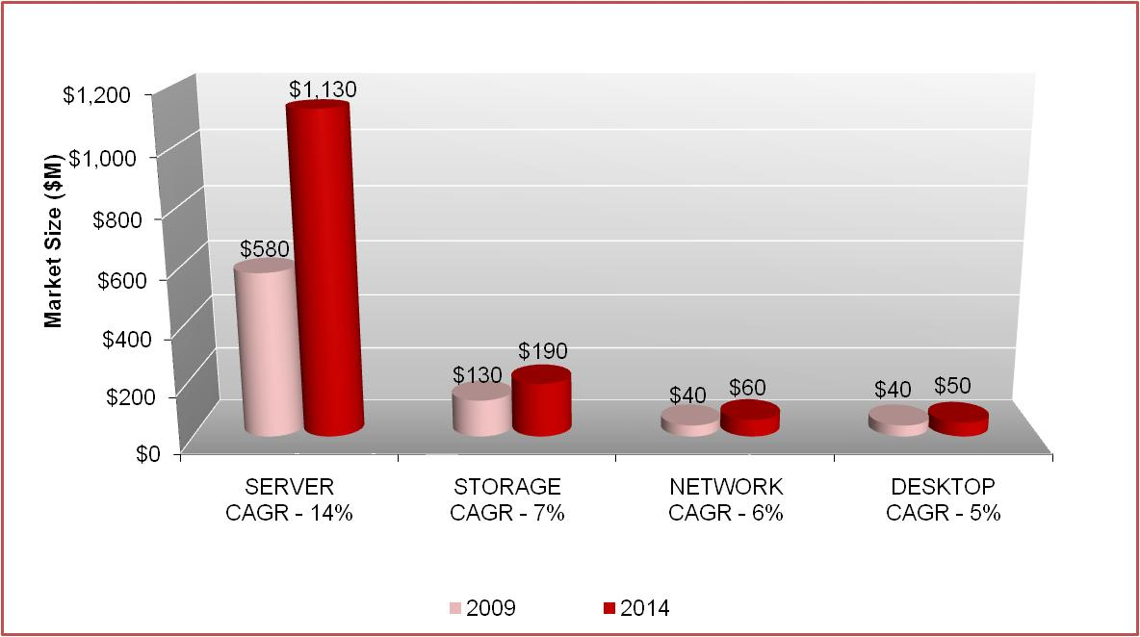
Federal Virtualization Market, FY2009-2014
Total Market CAGR – 12%
Source: INPUT
Notes:
The virtualization market is poised to grow from approximately $800M in FY09 to $1.4B in FY14. Server virtualization represents the largest segment.
The total market Compound annual Growth Rate (CAGR) is significant, especially compared to the total market CAGR of 3.5%.
Storage virtualization will see a slight increase as well, as transparency requirements increase the volume of data the needs to be stored, managed and accessed.
These figures were prior to the consolidation initaitive announcement this winter, so they will likely go higher .

Slide 26
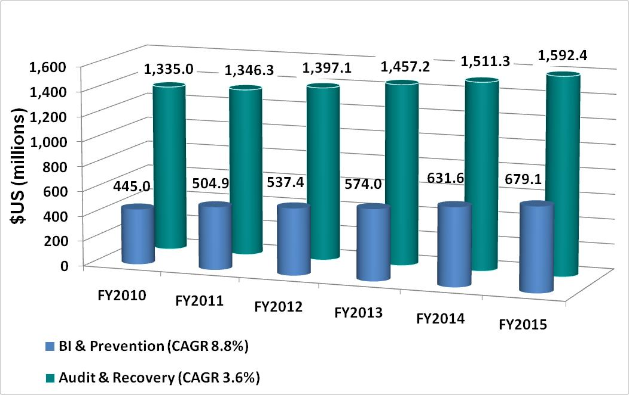
Federal Anti-WFA IT Market, 2010-2015
Source: INPUT
Notes:
For purposes of this forecast, INPUT has created two “bucket” categories for anti-WFA IT solutions as follows:
Audit & Recovery:
Investigative case management systems
Mobility solutions for investigators
Data mining/analytics of post-payment data
Cross-matching of data against other government programs (e.g., vital records, employment registries, etc.)
Automated query and reporting tools
Automated flagging tools
Online fraud reporting sites
Business Intelligence (BI) & Prevention:
Online benefits application solutions
Identity verification tools (e.g., SSN, last known address, citizenship/residency, etc.)
Personal identification numbers (PINs) for online benefits management
Security and privacy enhancements
Online education tools
Help desk services
Document imaging and management systems
Cross-matching of data against other—primarily neighboring—state governments’ and federal programmatic records
Data mining/analytics for screening of pre-payment data
Demographic and geographic analysis
Automated query and reporting tools
Background checks against private-sector data sources (e.g., credit records, etc.)
Automated flagging tools
Electronic benefits transfer (EBT) and other point-of-service (POS) solutions that reduce WFA exposure and provide near real-time activity data for data mining/analysis
WFA investment is a very small portion of the overall program outlay. BI/prevention tools are cheaper than audit/recovery because audit and recovery requires lots of code/hardware modernization to achieve integration. BI&P relies on data warehouses/indexes rather than reconfiguration of the original platforms/data sets or shipping massive data sets over to contractors to sort out.

Slide 27
Navigating the Complex Cyber-security Environment
Growing Attacks
Increasing Challenges
Transparency vs. Security
Changing Technologies
Limited Network Visibility
Emerging Standards
Leadership Ambiguity
Monitoring
Varied Remedies
Cyber Czar
Layered Security
Offensive Tactics
Dept. Programs
User Training
Legislation
FISMA, ID Mgmt, etc.
Outcomes
The federal information security market will grow from $8 billion to $12 billion in 2014 at a CAGR of over 8 percent.
Increased Vulnerability
Limited Progress

Slide 28
INPUT’s Take
“Near-term” technology priorities revolve around:
Consolidation
Advancing information security
Transparency and accountability
“Long-term” technology priorities revolve around:
Health IT adoption
Energy/environment (renewable energy, advanced battery manufacturing, smart grid)
Contractors should stay aware of evolving acquisition reforms
Traditionally “closed” agencies and vehicles may again become accessible.

Slide 29
Q&A

